Slide 1


Fullstack Java Course
Training Overview
Version : v1.0
Trainer Name: Vijay Kumbhar
Experience: 9+ Yrs

Slide 2



Trainer Profile:
Vijay is the independent Trainer & Facilator with over 8 years of experience. He has established his expertise in Java Development with multiple frameworks. He works across Service and Product Based companies.
Masters in Computer Application Education from MIT-SOM Pune.
Handled Problem Solving, Issue Analysis, Development, Project Management, Build Deployment, Process management
Currently working in Finance Domain as Project Architect.

Slide 3

Overview of the complete Syllabus:
Core Java
Spring
Hibernate
Spring Boot
Mongo DB with Spring boot
Database (mysql)
Micro Services
UI Development | HTML 5 | CSS3 |Java Script
Advanced Java Script | Boot strap | Angular
Jquery | Ajax
Angular JS
DevSecOps Tools
Jenkin
Maven
Cloud – Application Deployment on Cloud (AWS,GCP and Azure

Slide 4
Introduction to Java :
Java programming language
The one we use to write our program
Compiled to byte code of JVM
Java virtual machine (JVM)
Java interpreter – interpret the compiled byte code
Software simulated CPU architecture
Cross-platform: support Linux, Windows, PalmOS…etc.
Java runtime environment (JRE)
Predefined set of java classes available to use
Core Java APIs – basic utilities, I/O, graphics, network…

Slide 5
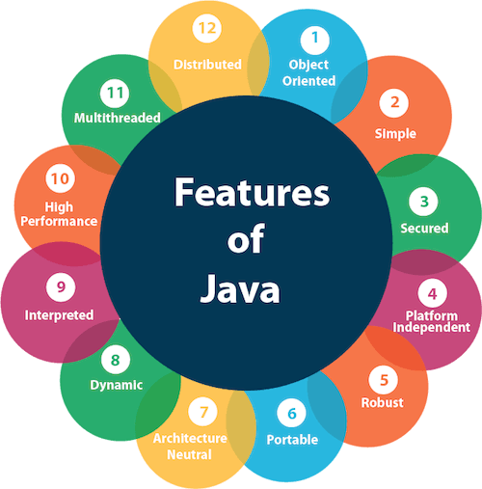

Importance of Technology

Slide 6
Java is portable
As long as there is a JVM compiled for that particular processor and OS
Typical program, like C or C++, is compiled for a particular processor architecture and OS.
“Write once, run everywhere!”
Sun’s motto for Java
Java is an object-oriented language, with a syntax similar to C
Structured around objects and methods
A method is an action or something you do with the object
Avoid those overly complicated features of C++:
Operator overloading, pointer, templates, friend class, etc.

Slide 7

How long the particular technology in the market
Java is one of the most popular programming languages worldwide. It was created by James Gosling and Patrick Naughton, employees of Sun Microsystems, with support from Bill Joy, co-founder of Sun Microsystems.
Sun officially presented the Java language at SunWorld on May 23, 1995. Then, in 2009, the Oracle company bought the Sun company, which explains why the language now belongs to Oracle.
In this article, we'll explore the history of the Java programming language
The project was born in 1991, behind the scenes of a Sun Microsystems team, when three engineers, James Gosling, Mike Sheridan, and Patrick Naughton sought to design a language applicable to small electrical devices. Soon after, they launched the Green Project to study the impact of convergence between digitally controlled home appliances and computers.
Using a syntax similar to that of C++, they made a digital remote control, equipped with a graphic and animated touch screen. The fruit of several months of intense research, this remote control had the fantastic feature of controlling a whole living room equipment. It was programmed in a new language, completely independent of the processor it was running on, making the remote one-of-a-kind

Slide 8

Future of technology for Next 5 to 10 years
Process automation and virtualization
By 2025, more than 50 billion devices will be connected to the Industrial Internet of Things (IIoT),” McKinsey predicts. Robots, automation, 3D-printing, and more will generate around 79.4 zettabytes of data per year.
Distributed infrastructure
By 2022, 70% of companies will be using hybrid-cloud or multi-cloud platforms as part of a distributed IT infrastructure. It will mean data and processing can be handled in the cloud but made accessible to devices faster.
Applied Artificial Intelligence (AI)
By 2024, AI-generated speech will be behind more than 50% of people’s interactions with computers. Companies are still searching for ways to use AI effectively though, the consultancy says: “While any company can get good value from AI if it’s applied effectively and in a repeatable way, less than one-quarter of respondents report significant bottom-line impact.”
Future of programming
Get ready for Software 2.0, where neural networks and machine learning write code and create new software. “This tech trend makes possible the rapid scaling and diffusion of new data-rich, AI-driven applications,” according to McKinsey.
In part, it could see the creation of software applications far more powerful and capable than anything available today. But it will also make it possible for existing software and coding processes to be standardized and automated.

Slide 9
Getting and using java
All text editors support java
Vi/vim, emacs, notepad, wordpad
Just save to .java file
Have IDEs that comparable to Visual Studio
JCreator (simple)
Eclipse
NetBeans
Visual Studio
Intelli J
Maven Configuration

Slide 10
Compile and run an application
Write java class HellowWorld containing a main() method and save in file “HelloWorld.java”
The file name MUST be the same as class name
Compile with: javac HelloWorld.java
Creates compiled .class file: HelloWorld.class
Run the program: java Foo
Notice: use the class name directly, no .class!

Slide 11
Example of Hello World:
/* Our first Java program – Hello.java */
public class Hello {
//main()
public static void main ( String[] args ) {
System.out.println( "hello world!" );
}
}
Command line arguments
Standard output, print with new line

Slide 12
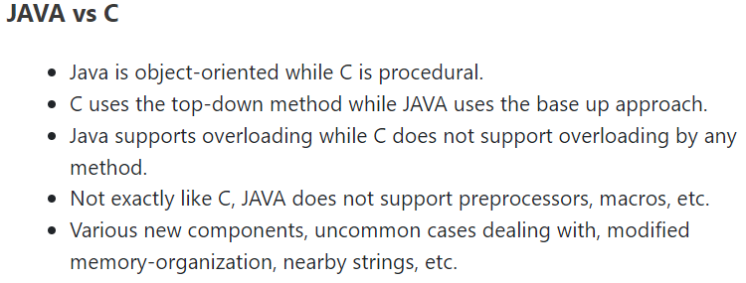
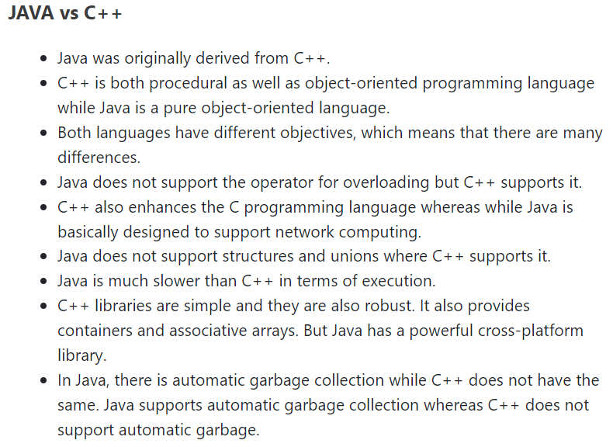
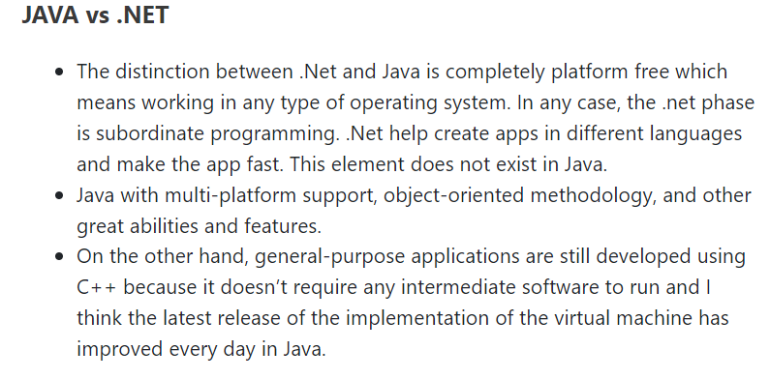
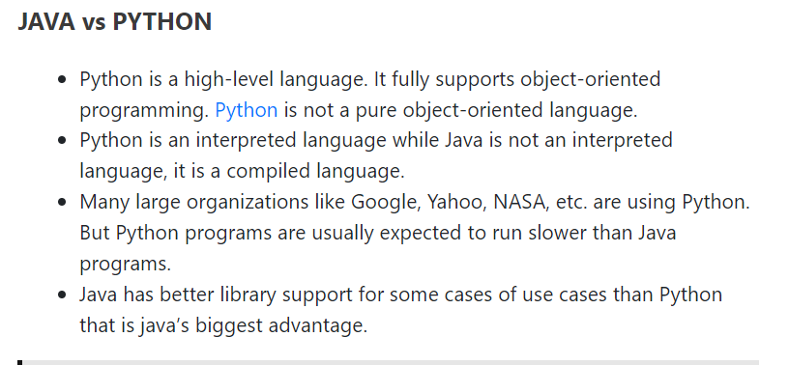
Differentiator from other parallel technologies in the market

Slide 13

Job Opportunities
Jr. Java Developer
Senior Java Developer
Java Web Developer
DevOps Engineer
Solution Architect
Full-stack Java Developer
Scrum Master
Project Lead
Assistant Project Manager
Project Manager

Slide 14
Similar competitors of that particular technology
Node JS
RxJS
Flutter

Slide 15

Brief About Certifications
Oracle Certified Professional, Java EE 7 Application Developer
Oracle Certified Associate, Java SE 8 Programmer
Oracle Certified Professional, Java SE 8 Programmer
Oracle Certified Foundations Associate, Java
Oracle Certified Professional: Java SE 11 Developer
Oracle Certified Professional: Java SE 17 Developer
Other Certificates
AWS Cloud Practioner
AWS Solution Architect

Slide 16

Questions & Answers ?

Slide 17
Thank you

